Slide 1
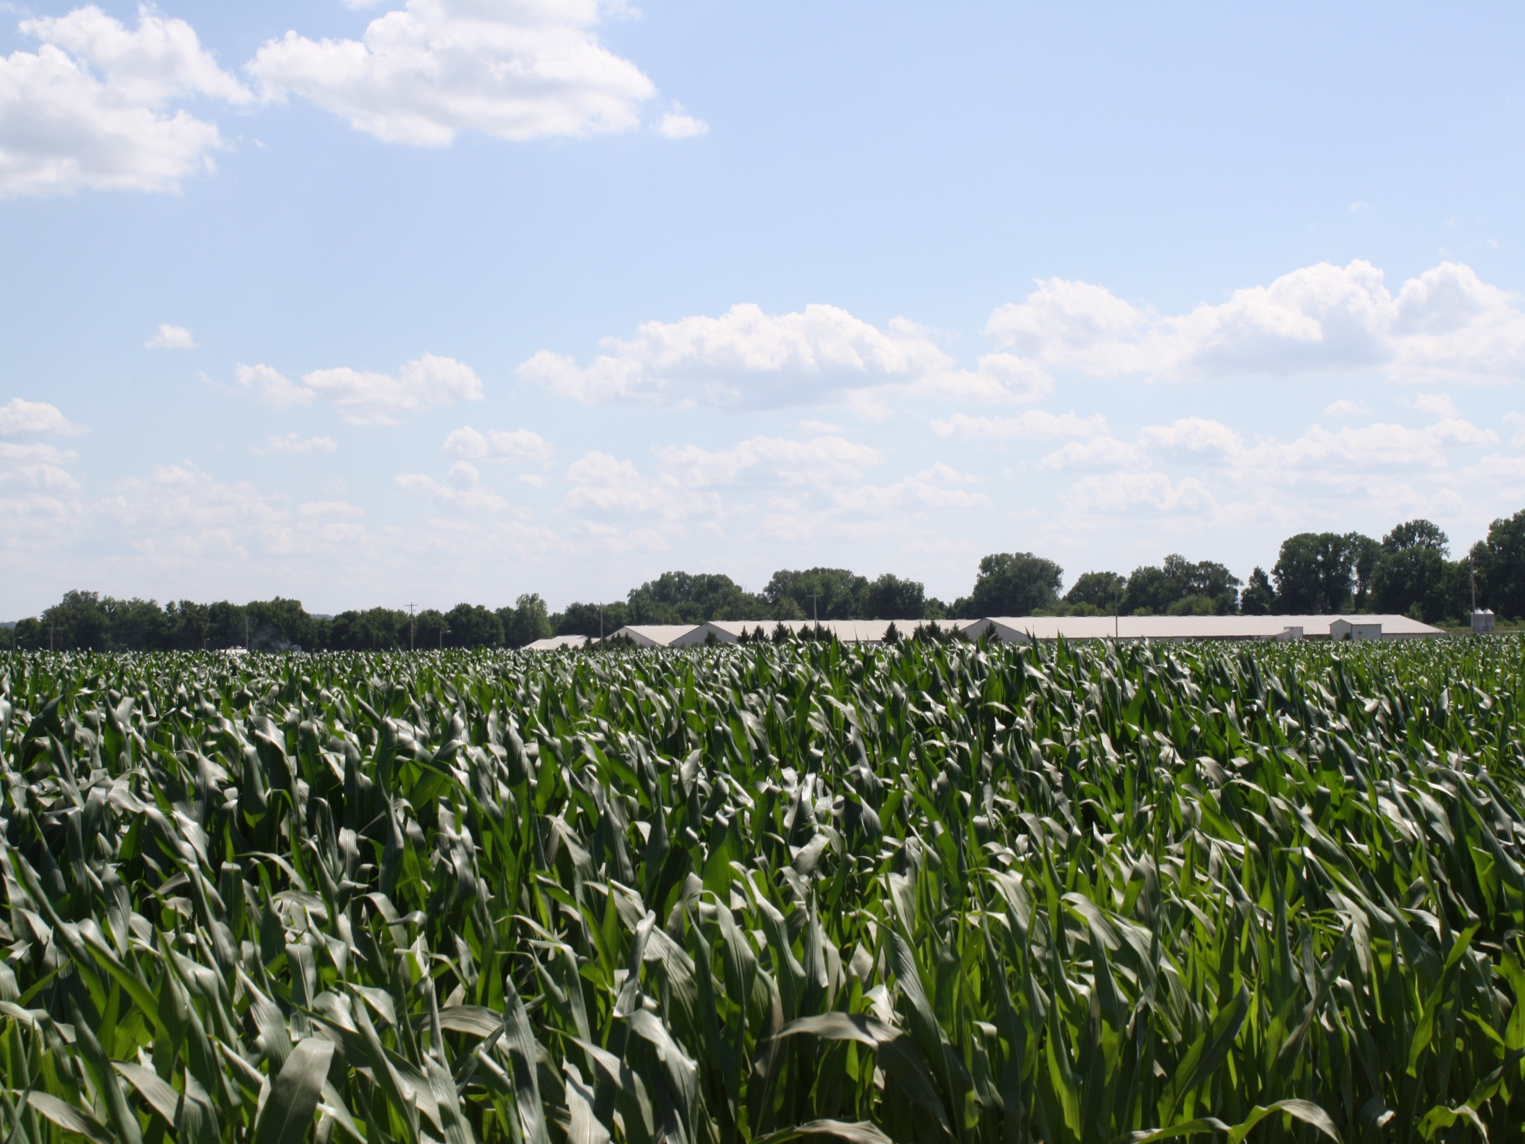
Conway County
Point Remove
Water Quality Project
Conway County Conservation District
PO Box 478
207 Shady Lane
Morrilton, Arkansas 72110

Slide 2
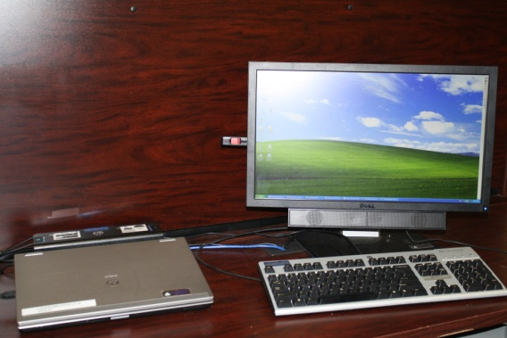
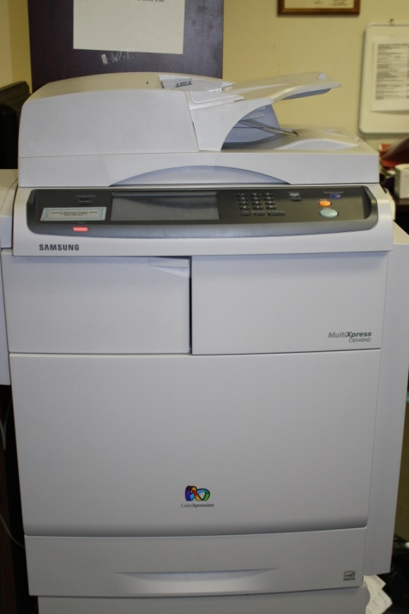
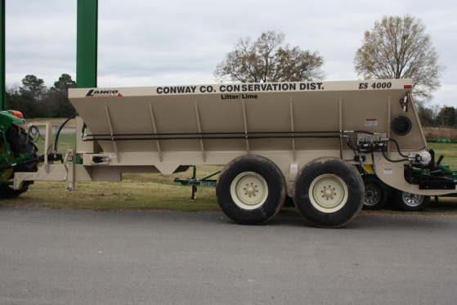
Equipment Purchased with Grant
Laptop
Copier
Manure Spreader

Slide 3

Manure Spreader
Landco Model ES-4000

Slide 4
Manure Spreader Usage
Manure Spreader Specs
18 Foot Bed
Self Contained Hydraulics
34 inch wide conveyor
Approximately 108 hours of Usage
Drought has effected the rental.

Slide 5
Drought within the
Conway County Point Remove Water Quality Project
115 Drought Applications
Approximately 70 are from the Project Area
31 of the 70 were approved for Drought Assistance

Slide 6

Annual Newsletter
Annual Newsletter
is sent to
Landowners in the
Project Area
Notes:
Approximately 800 on the mailing list

Slide 7
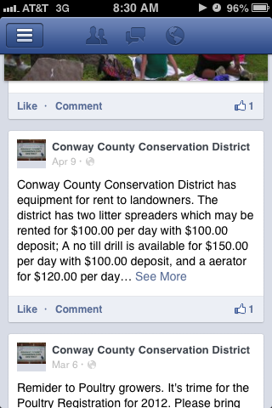
Facebook
Landowners have
access to
Conway County
Point Remove
Water Quality Project announcements on the Conway County Conservation District Facebook page.

Slide 8
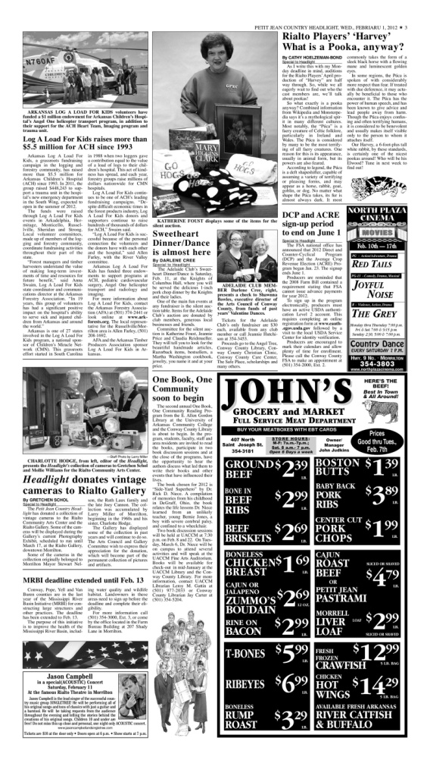
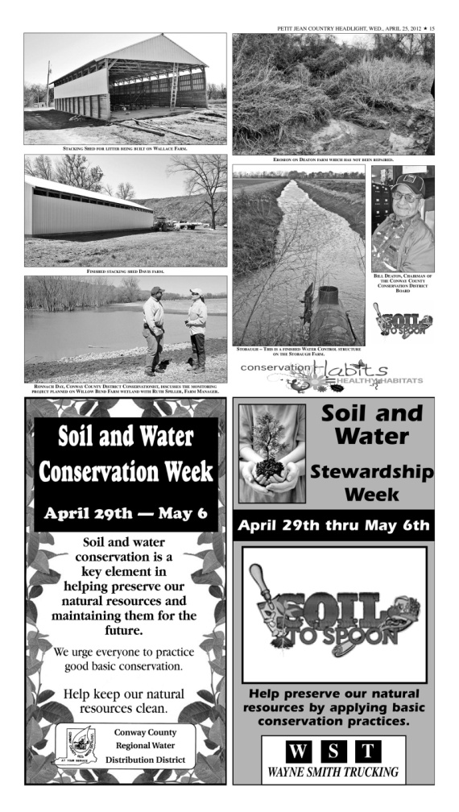
Newspaper Articles
MRBI Deadline Extended to Feb. 13
Best Management Practices Implemented in the Project Area
Announcements are also sent to Morrilton Community Channel 6

Slide 9
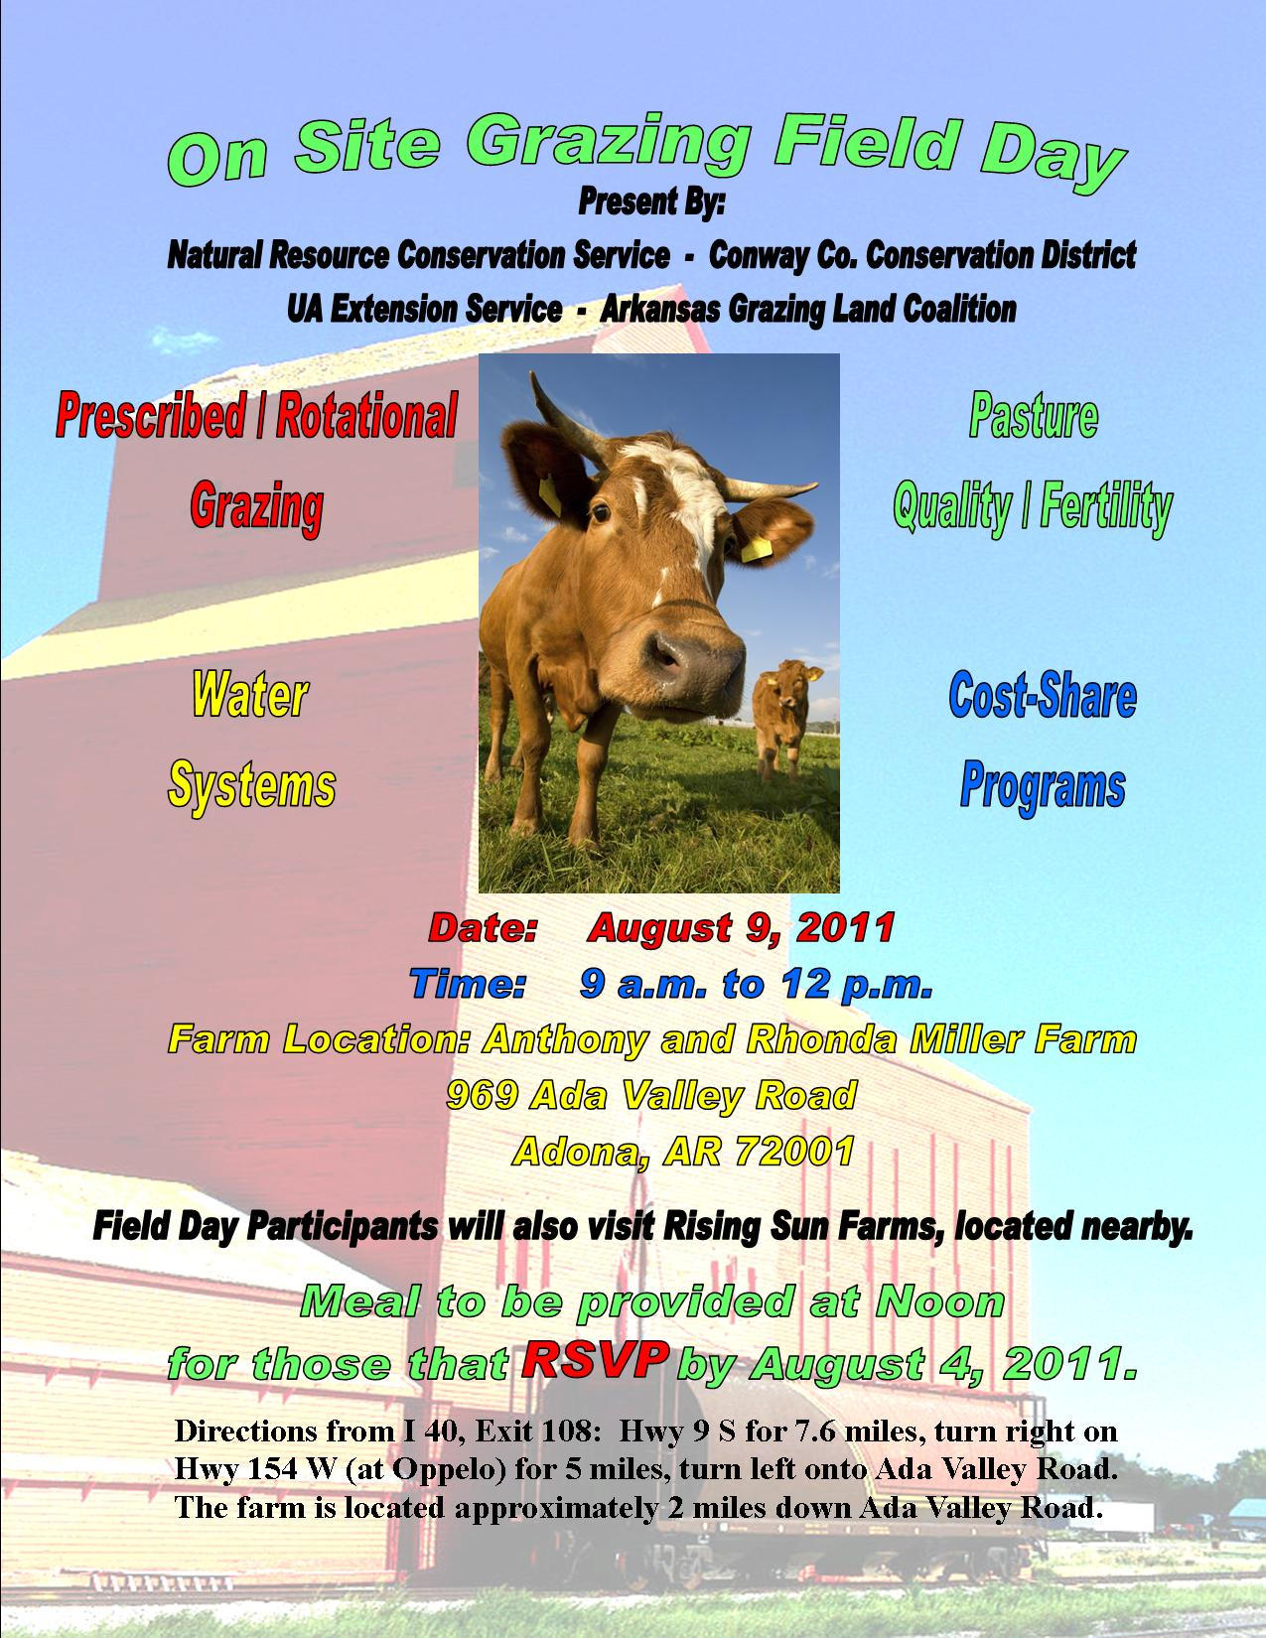
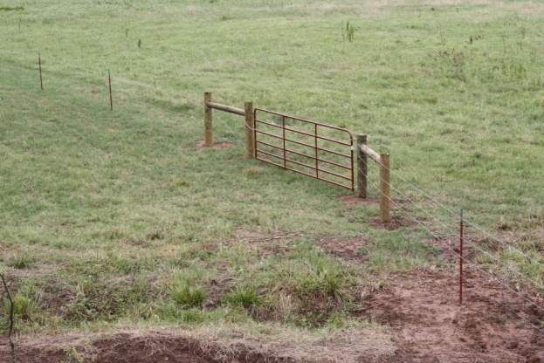
Grazing Field Day 2011
Grazing Field Day
Featuring 2 Farms in the Project Area
Cross Fencing at
Rising Sun Farms

Slide 10
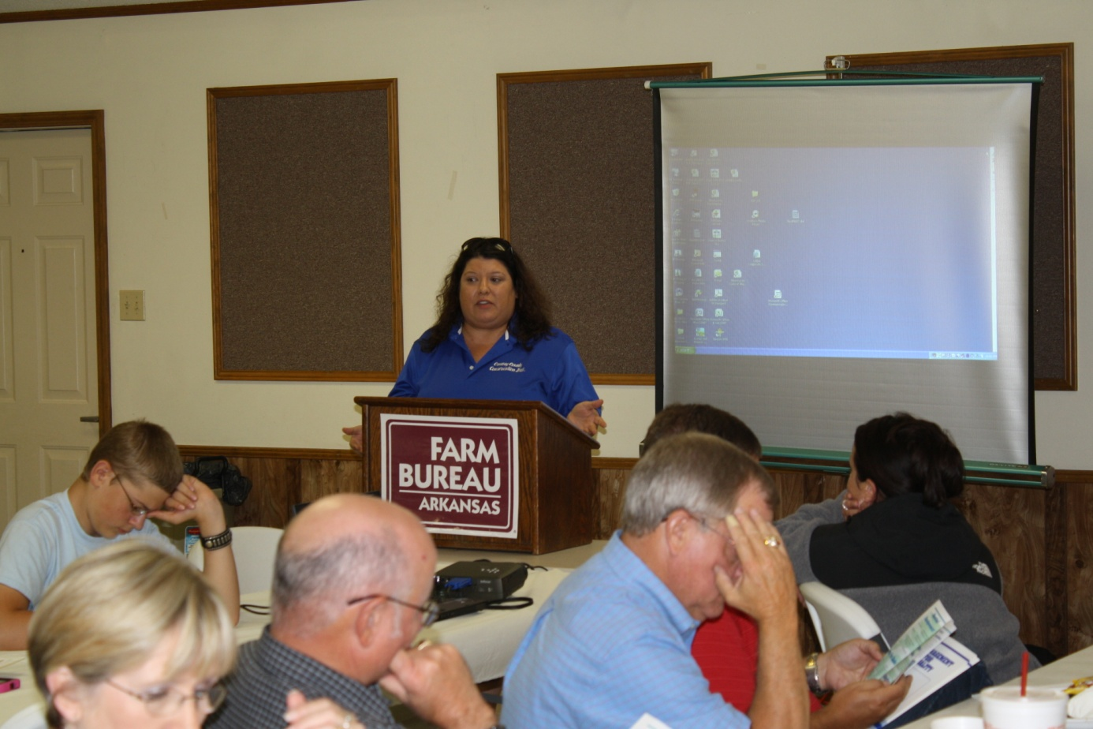
2011 Conway County
Outreach Meeting

Slide 11
Nutrient Management Plans
25 Plans Completed
Between July 1, 2011 to June 30, 2012
Covering over 3,000 acres.

Slide 12
Best Management Practices
Anthony and Rhonda Miller Farm
Practices Implemented with Assistance from MRBI Cost Share Program

Slide 13
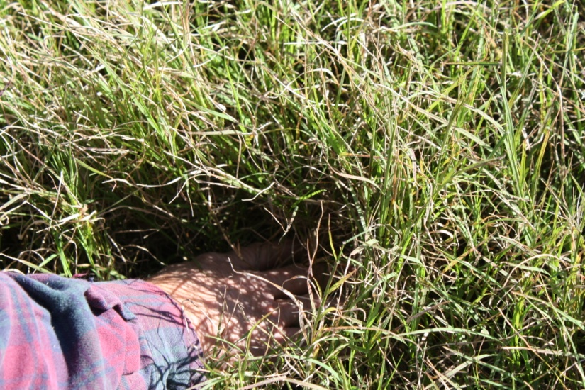
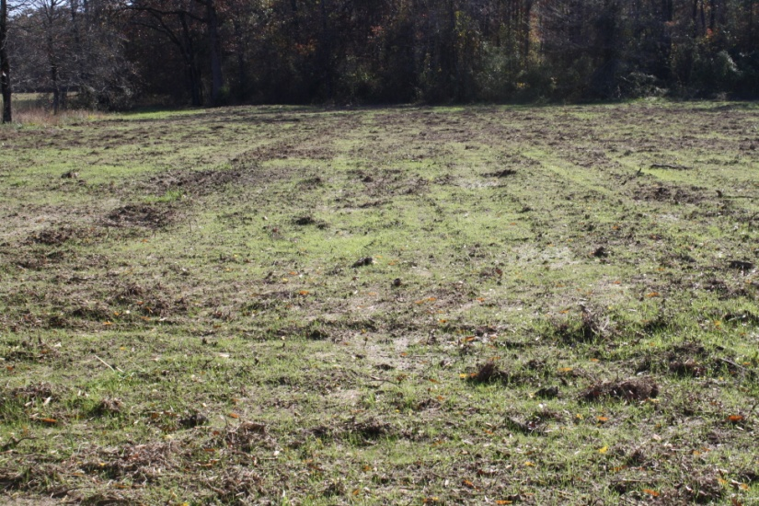
Anthony and Rhonda Miller
Forage and Biomass
Planting (512)
Upland Wildlife Management (645)

Slide 14
Best Management Practices
Pettingill Farm
Practices Implemented with Assistance from MRBI Cost Share Program

Slide 15
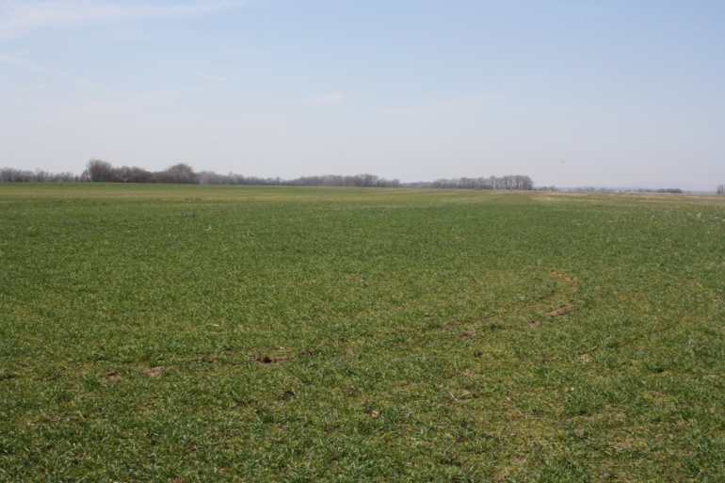
Pettingill Farm
Deep Tillage (324)
Waste Transfer (634)
Drainage Water Management (554)
Heavy Use Protection Area (561)
Stream Crossing (578)
Structure for Water Control (587)
Conservation Crop Rotation (328)
Cover Crop (340)

Slide 16
Best Management Practices
Willow Bend Farms
Practices Implemented with Assistance from MRBI Cost Share Program

Slide 17
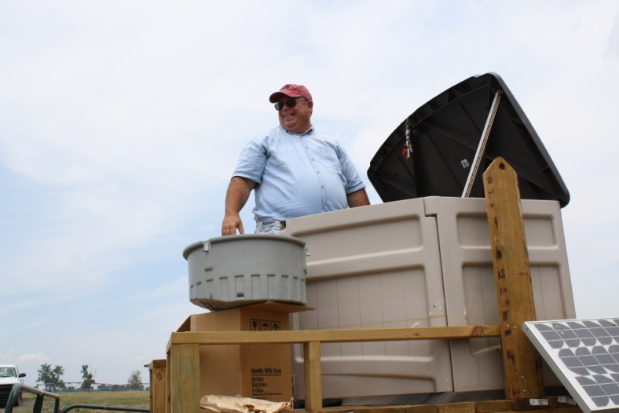
Willow Bend
Waste Transfer (634)
Waste Utilization (633)
Cover Crop (340)
Nutrient Management (590)
Structure for Water Control (587)
Fence (382)
Wetland Enhancement (659)
Monitoring & Evaluation (799)

Slide 18
Best Management Practices
Gregory Brothers Farms
David Gregory
Practices Implemented with Assistance from MRBI Cost Share Program

Slide 19
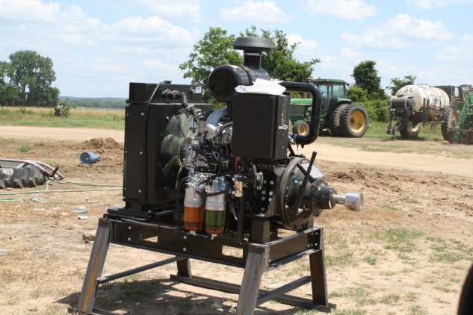
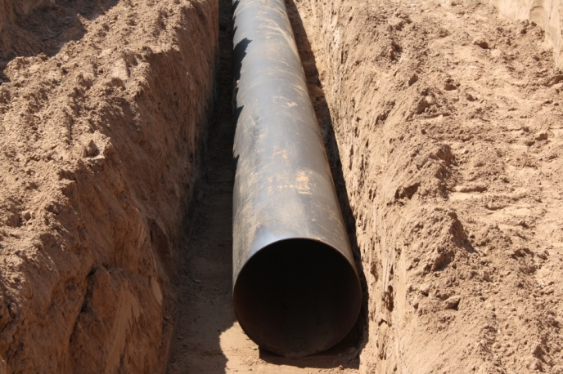
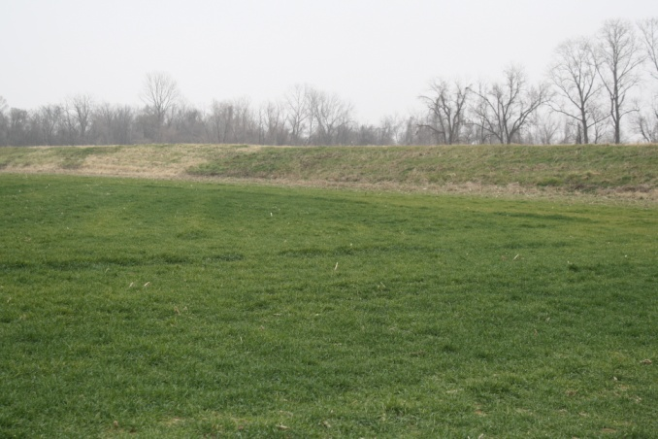
Gregory Brothers Farms/David Gregory
Deep Tillage (324)
Conservation Crop Rotation (328)
Stream Crossing (578)
Structure for Water Control (587)
Heavy Use Area Protection (561)
Waste Transfer (634)
Waste Utilization (533)
Critical Area Planting (342)
Residue & Tillage Management (329)
Pumping Plant (533)
Grade Stabilization Structure (410)
Cover Crop (340)

Slide 20
Upcoming Goals
Develop 25 additional plans
Continue to advertise and rent equipment
2012 Grazing Day in the Project Area - Completed

